Slide 1
Web Development Credential – Week 2
Josh Kohn
Danny Laurence

Slide 2
Relational Databases & SQl

Slide 3
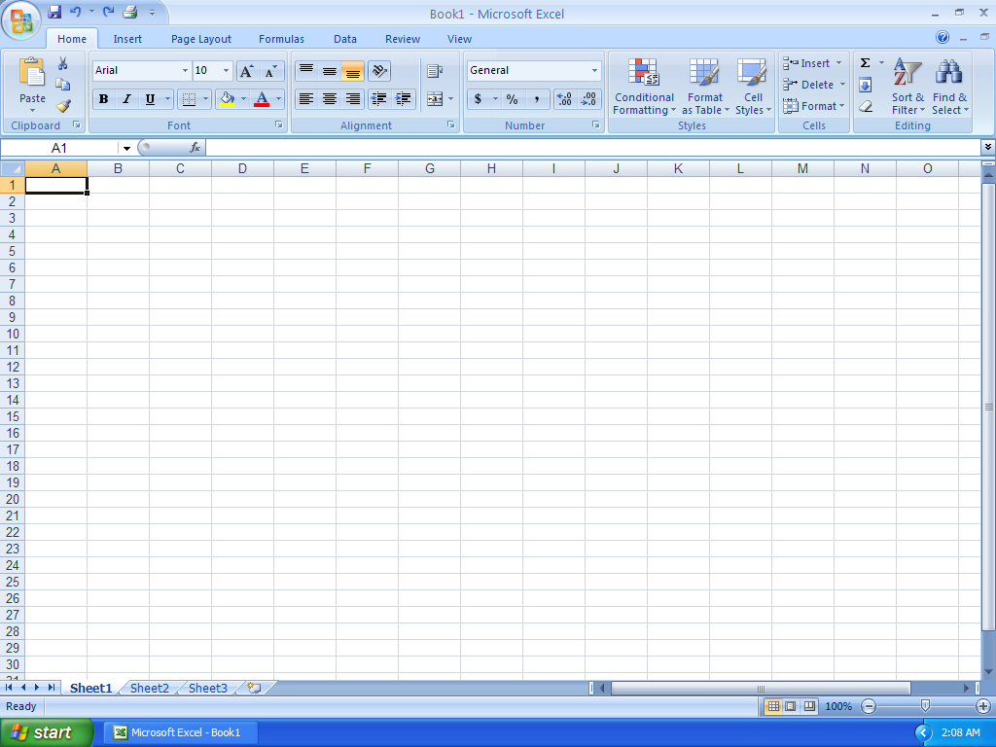
What is a Database?
Nothing more than a holding space for objects

Slide 4
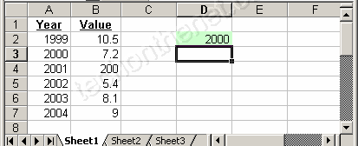
What is a table?
Where the information is actually stored
Var
Record
Table 1
Table 2

Slide 5

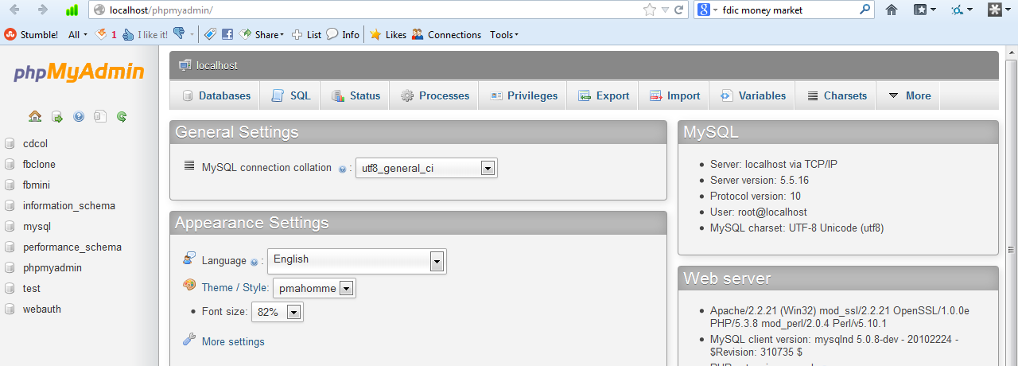
Let’s play with Databases!

Slide 6
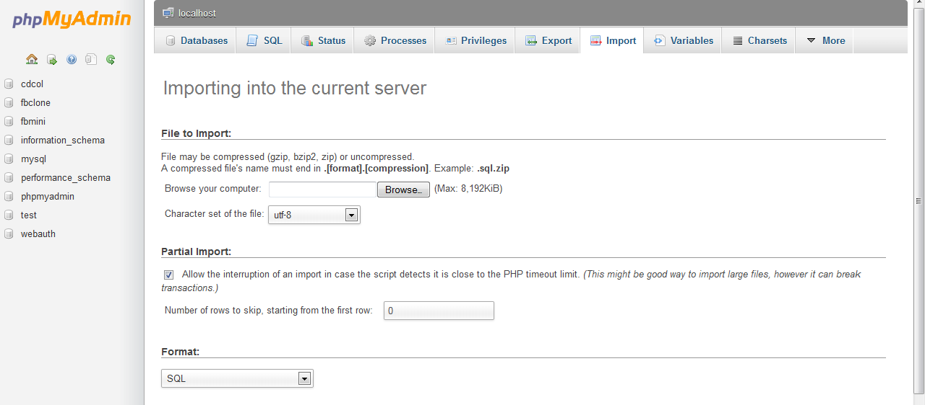
Load the Database

Slide 7
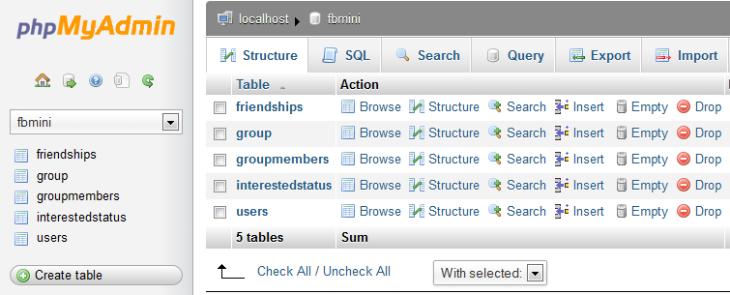
Welcome to FBmini

Slide 8
Basic SQL Query Syntax
SELECT: what data you want your query to retrieve
FROM: what table do you want your information from
WHERE: any conditions on your data?
ORDER BY: how would you like it sorted?

Slide 9
Simple Queries
Select everything from Users table
Select only first and last names from Users table
Above query, sorted by last name
Above query, sorted by interest and then last name

Slide 10
Joining
Key to databases – relationships!
Access data from multiple tables with one query
SELECT … FROM table1
JOIN table 2
On table1.field1 = table2.field2
Example: get first name, last name, romantic interest for everyone in QUEST
Hint: Two tables are users and interestedstatus
You can join multiple tables!
Example find names of all members of Cohort 18

Slide 11
Insert Data
INSERT INTO table (specified columns)
VALUES (…..)
For instance: what would this do?
INSERT INTO users (firstName, lastName)
VALUES (‘Purtilo’, ‘Jim’)
Why can we do that?

Slide 12
UPDATE data
Say you spelled your name wrong. What would you do?
UPDATE users
SET lastName = ‘newName’ WHERE user_id = x
You can update as many or as few rows at a time as you like

Slide 13


DELETE Data
DELETE
FROM table
WHERE …
Be very careful with your where
statement. This can end badly

Slide 14


DROP Table
DROP TABLE tableName

Slide 15
Let’s make your first database!
CREATE DATABASE name
CREATE TABLE tableName (
Id INT,
name VARCHAR(255) NOT NULL,
lotsOfText TEXT,
……
)

Slide 16
ADVANCED

Slide 17
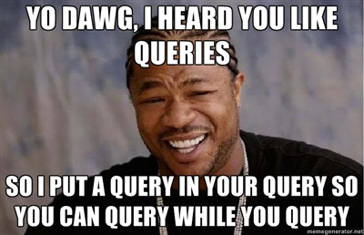
Subqueries and Aliasing
Run a query within a query
What do you think this does?
SELECT u.firstName, u.lastName
FROM users u
JOIN friendships f
ON f.friend2 = u.user_id
WHERE f.friend1 = (SELECT user_id from users where lastName = 'Bailey')

Slide 18
UNIONS
SQL Select Union Code:
SELECT * FROM employees
UNION
SELECT * FROM employees2;
ID | Lastname | Firstname | Title
1 | Johnson | David | crew
2 | Hively | Jessica | crew
9 | Hicks | Freddy | crew
10 | Harris | Joel | crew
11 | Davis | Julie | manager
101 | Yazzow | Jim | crew
102 | Anderson | Craig | crew
103 | Carlson | Kevin | crew
104 | Maines | Brad | crew

Slide 19
SQL Functions
Math functions: AVG, SUM, COUNT, LOG…
String functions: CONCAT, LOWER, UPPER
Date: GET_DATE, DATE_ADD, DATE_DIFF

Slide 20
jQuery

Slide 21
What is jQuery?
A library on top of Javascript that makes your life much easier
Well then, what is Javascript?

Slide 22
Where do I put it?
Load the jQuery library:
In the head tag:
<script src="http://code.jquery.com/jquery-1.9.1.min.js"></script>
<script src="http://code.jquery.com/jquery-migrate-1.1.1.min.js"></script>
External file: *.js
In the html file:
<script type="text/javascript">
…..
</script>

Slide 23
How Do I Structure My Code?
Code runs on page load:
$(document).ready(function(){
//Put Code Here
};
Functions: Blocks of code that can be called at other times

Slide 24
Selecting objects on the page
Tag type: $(“p”)
ID: $(“#id”)
Class: $(“.class”)
Merge types: $(“p .question”)

Slide 25
Altering objects on the page
Jquery can:
Alter text
Insert tags
Add / remove classes
Move tags around
Set attributes
And more
Example: Changing Font Size
http://jsfiddle.net/AaT9b/

Slide 26
Expandable Paragraph
http://viralpatel.net/blogs/dynamically-shortened-text-show-more-link-jquery/

Slide 27
Mouse Clicks
http://api.jquery.com/click/

Slide 28
UI Elements
http://jqueryui.com/demos/

Slide 29
Form Validation
Warning – still do server-side validation

Slide 30
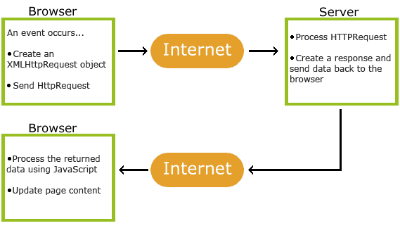
AJAX
Normally, sending a request reloads the WHOLE page
AJAX uses javascript to update parts of the page
Examples?

Slide 31
Example: Autocomplete
http://www.sks.com.np/article/9/ajax-autocomplete-using-php-mysql.html
http://stackoverflow.com/questions/12212887/how-to-get-jquery-autocomplete-with-php-mysql-ajax-and-pass-to-javascript
http://jqueryui.com/resources/demos/autocomplete/remote-jsonp.html

Slide 32
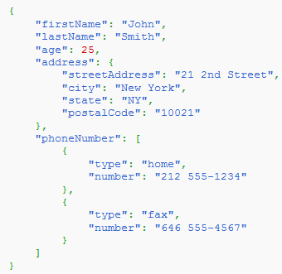
JSON
Format to pass data in a human-readable fashion
Example: Describe an address record

